Slide 1
TCP Congestion Control

Slide 2
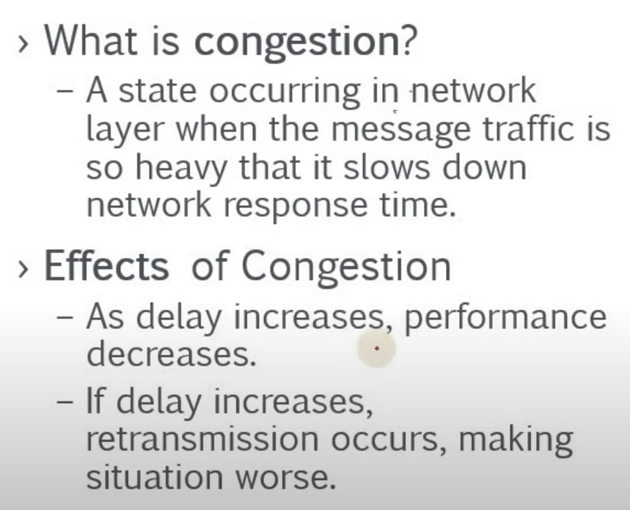

Slide 3
Window size
Generally the sender window size is determined by the available buffer space in the receiver (rwnd).
If the network cannot deliver the data as fast as they are created by the sender, it must tell the sender to slow down.
In other words, in addition to the receiver, the network is a second entity that determines the size of the sender's window.
Actual window size = minimum (rwnd, cwnd)
rwnd- receiver window; cwnd- congestion window

Slide 4
Congestion policy
TCP's general policy for handling congestion is based on three phases:
Slow start,
Congestion avoidance,
Congestion detection.

Slide 5
Slow start
Slow Start: Exponential Increase
One of the algorithms used in TCP congestion control is called slow start.
This algorithm is based on the idea that the size of the congestion window (cwnd) starts with one maximum segment size (MSS).

Slide 6
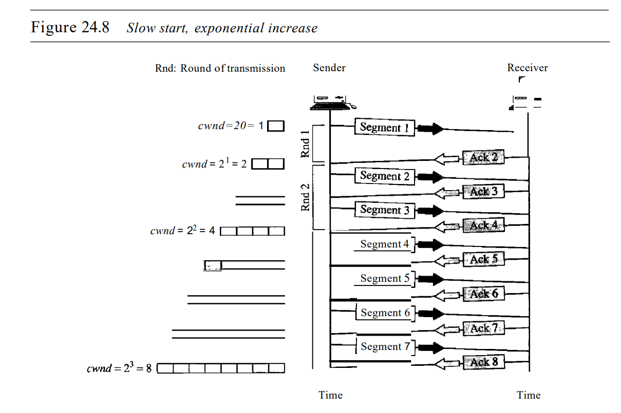

Slide 7
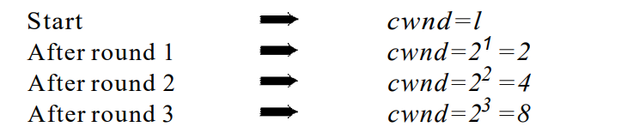
In the slow-start algorithm, the size of the congestion window increases exponentially until it reaches a threshold.

Slide 8
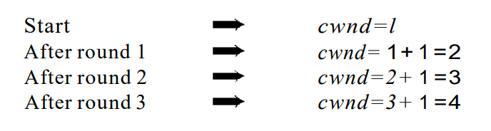
Congestion avoidance
Congestion avoidance- which undergoes an additive increase instead of an exponential one.
When the size of the congestion window reaches the slow-start threshold, the slow-start phase stops and the additive phase begins.
In the congestion avoidance algorithm, the size of the congestion window increases additively until congestion is detected

Slide 9
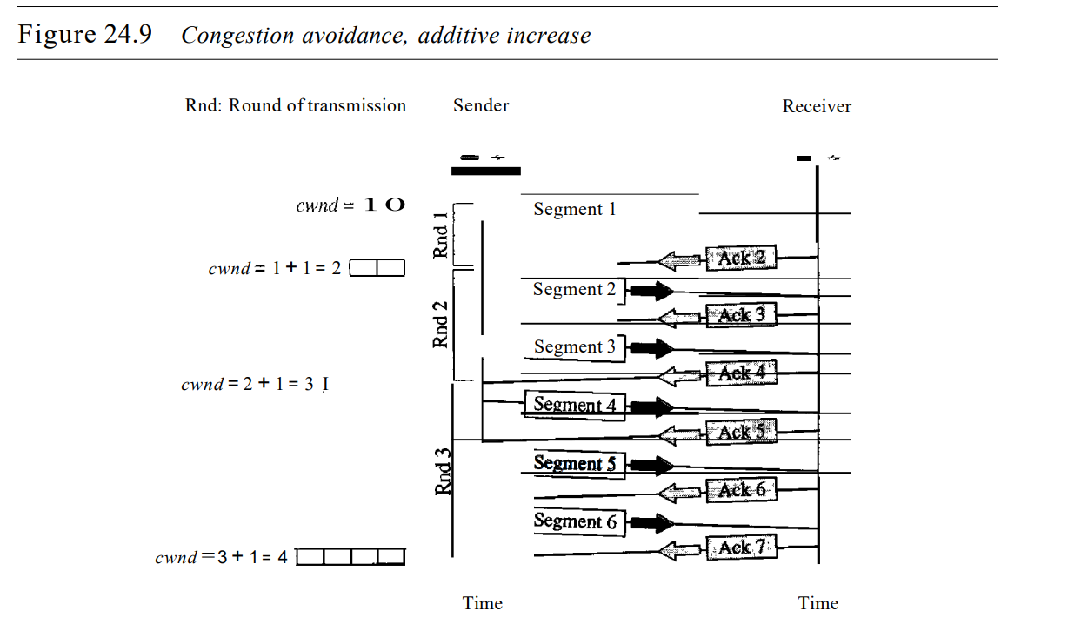

Slide 10
Congestion Detection
Congestion Detection: Multiplicative Decrease
If congestion occurs, the congestion window size must be decreased.
The only way the sender can guess that congestion has occurred is by the need to retransmit a segment.
However, retransmission can occur in one of two cases: when a timer times out or when three ACKs are received.

Slide 11
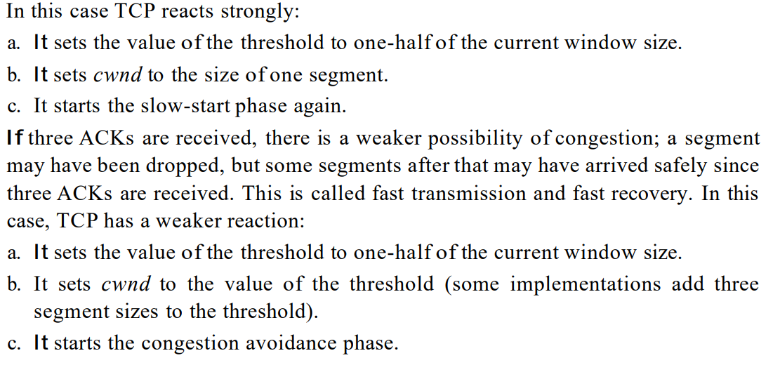
I. If a time-out occurs, there is a stronger possibility of congestion; a segment has probably been dropped in the network, and there is no news about the sent segments.

Slide 12
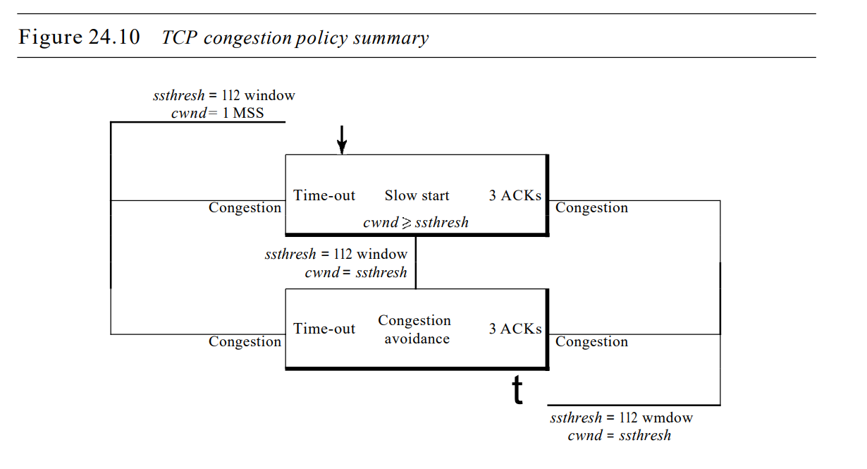

Slide 13
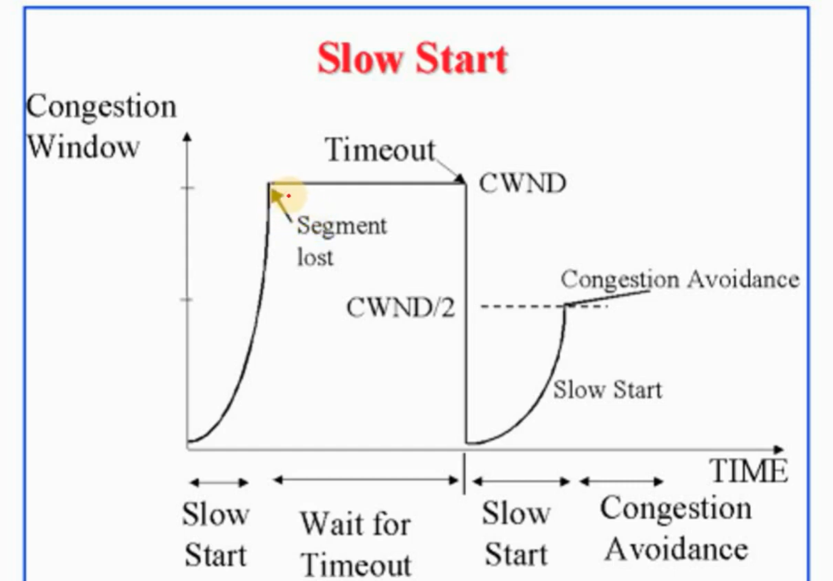

Slide 14
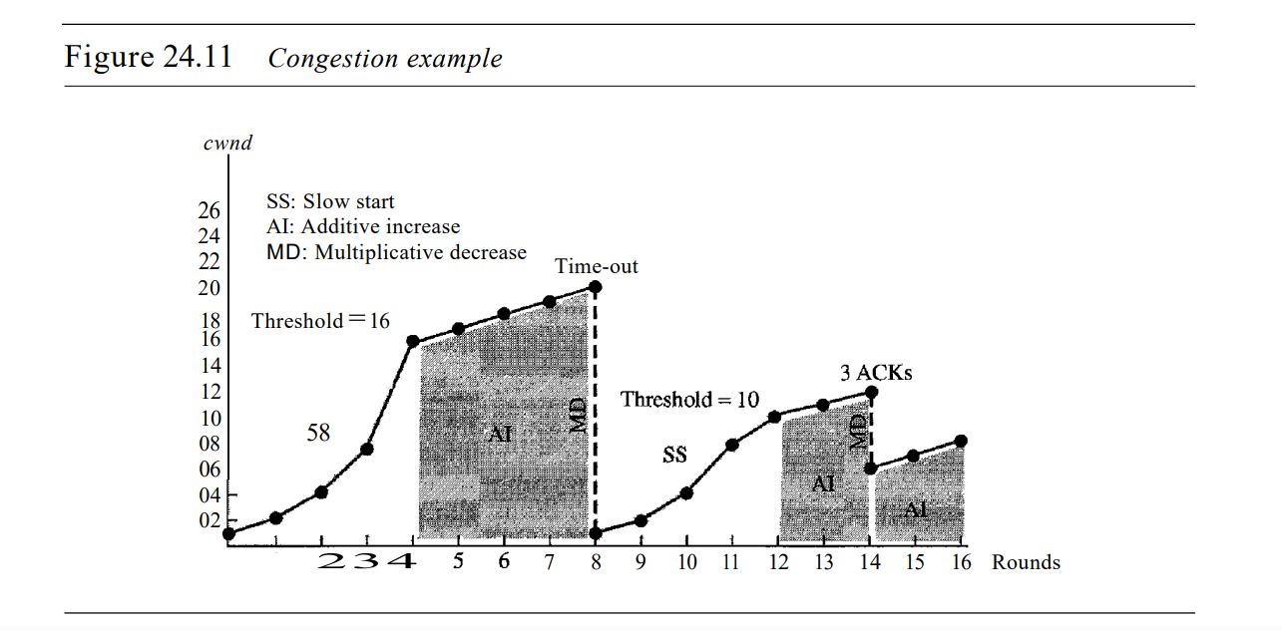

Slide 15
Congestion Control in Frame Relay
BECN The backward explicit congestion notification (BECN)
FECN The forward explicit congestion notification (FECN)

Slide 16
BECN
The backward explicit congestion notification (BECN) bit warns the sender of congestion in the network.
One might ask how this is accomplished since the frames are traveling away from the sender.
In fact, there are two methods:
The switch can use response frames from the receiver (full-duplex mode), or
Else the switch can use a predefined connection to send special frames for this specific purpose.
The sender can respond to this warning by simply reducing the data rate.

Slide 17
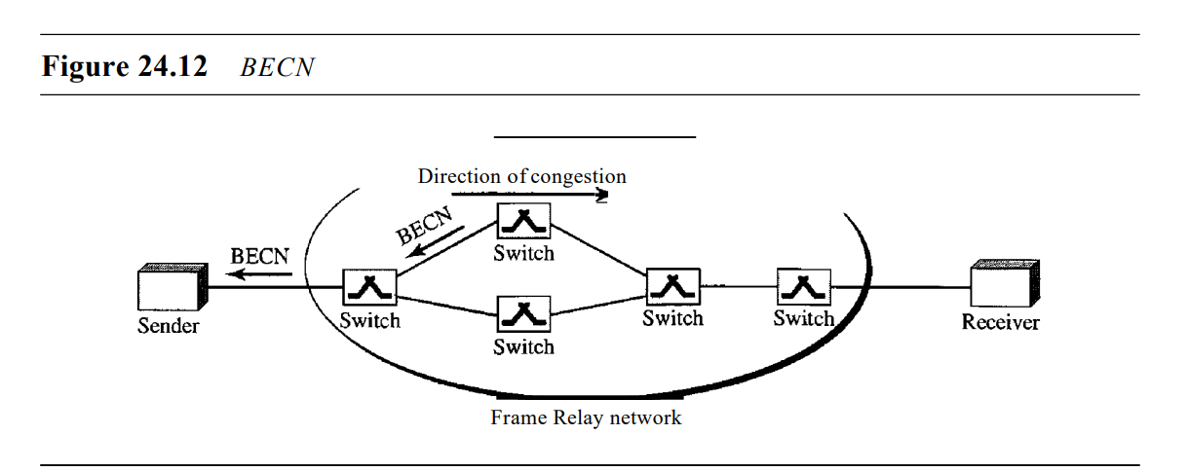

Slide 18
FECN
The forward explicit congestion notification (FECN) bit is used to warn the receiver of congestion in the network.
It might appear that the receiver cannot do anything to relieve the congestion.
However, the Frame Relay protocol assumes that the sender and receiver are communicating with each other and are using some type of flow control at a higher level.
For example, if there is an acknowledgment mechanism at this higher level, the receiver can delay the acknowledgment, thus forcing the sender to slow down

Slide 19
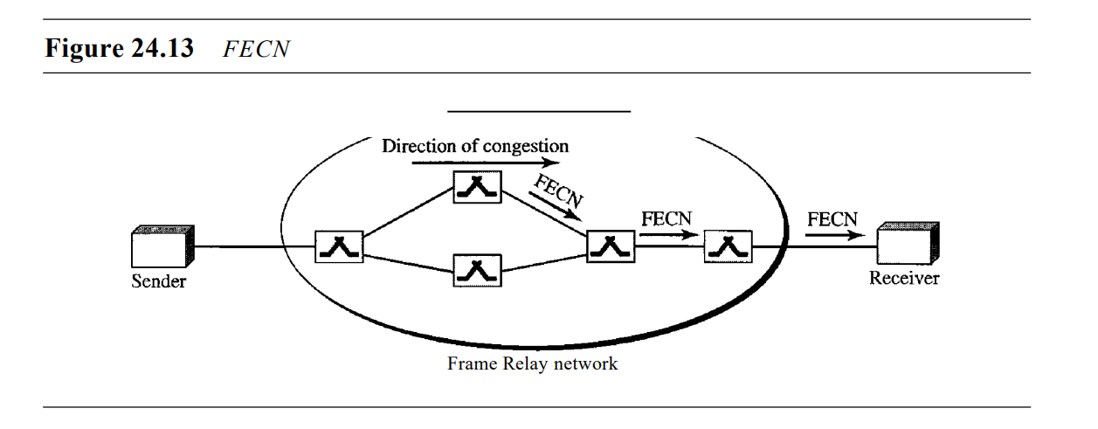

Slide 20
